Slide 1


Aligning and Coding
Sexual Harassment laws in India
The Role of the State Machinery
Dr. MANJUNATH G
WELFARE COMMISSIONER, DEPARTMENT OF LABOUR &
DIRECTOR, KARNATAKA STATE LABOUR INSTITUTE ,
GOVERNMENT OF KARNATAKA
www.drmanjunathg.in

Slide 2
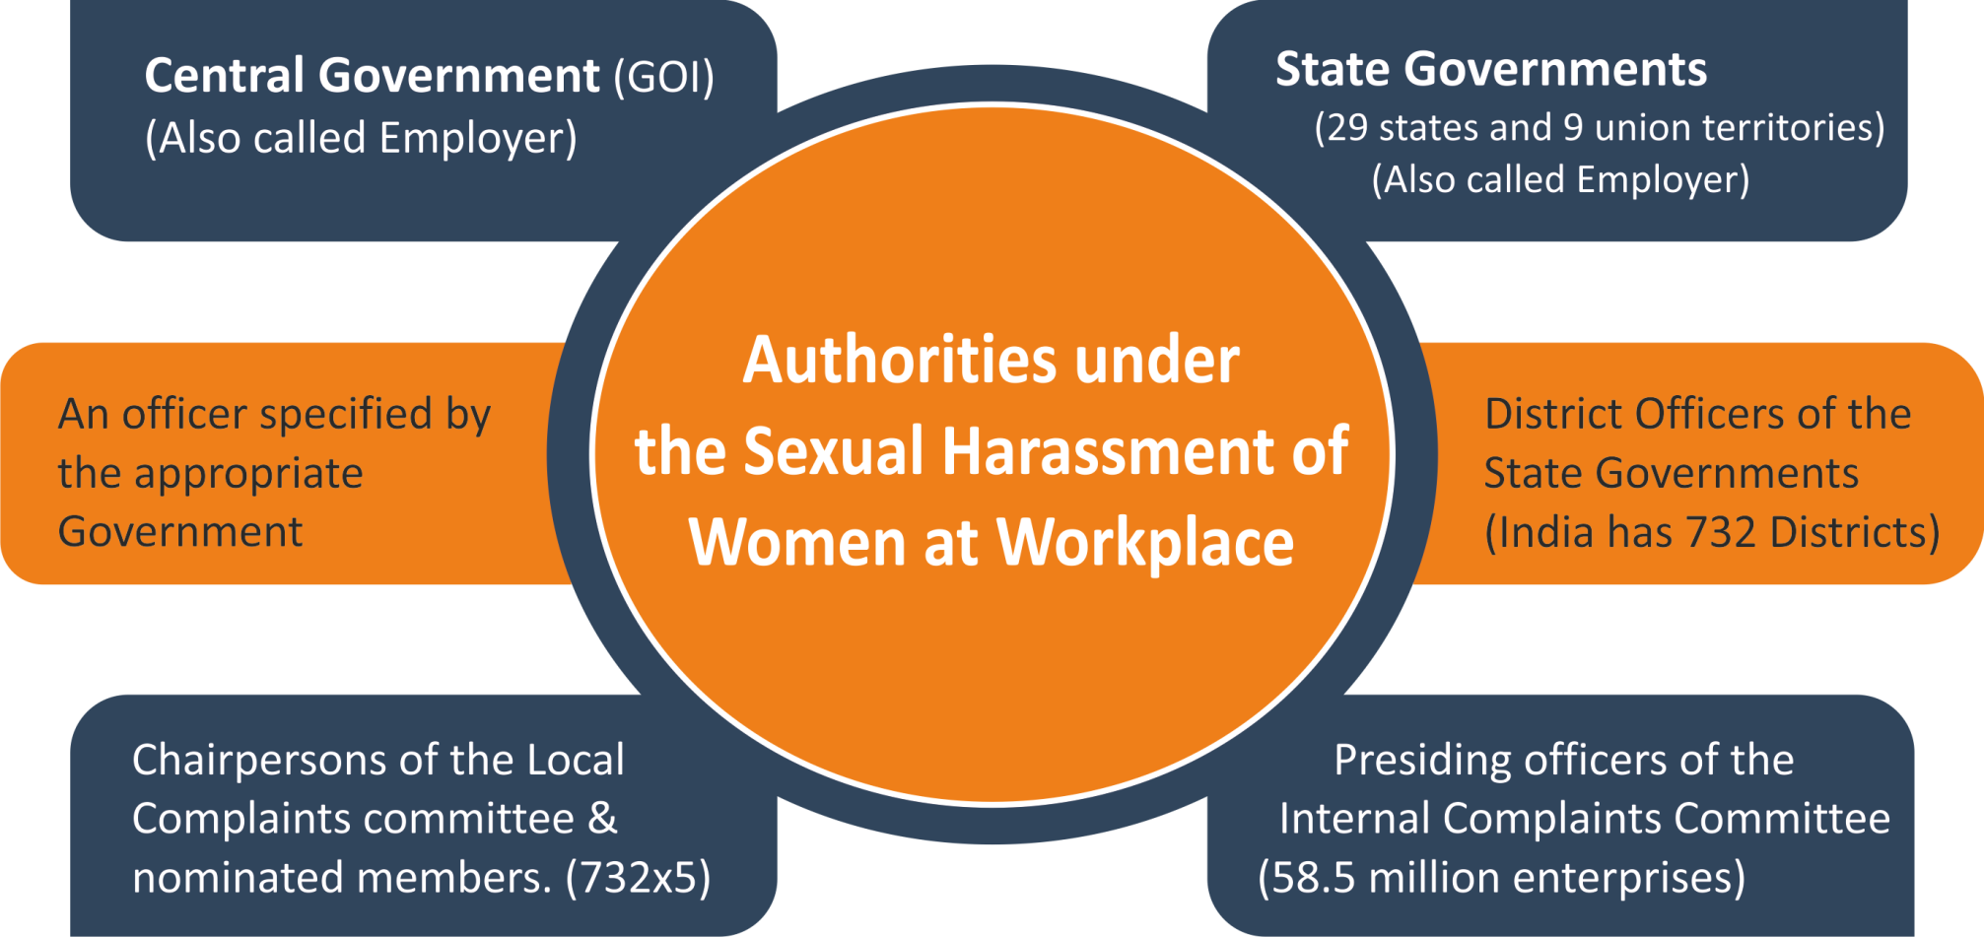

Slide 3
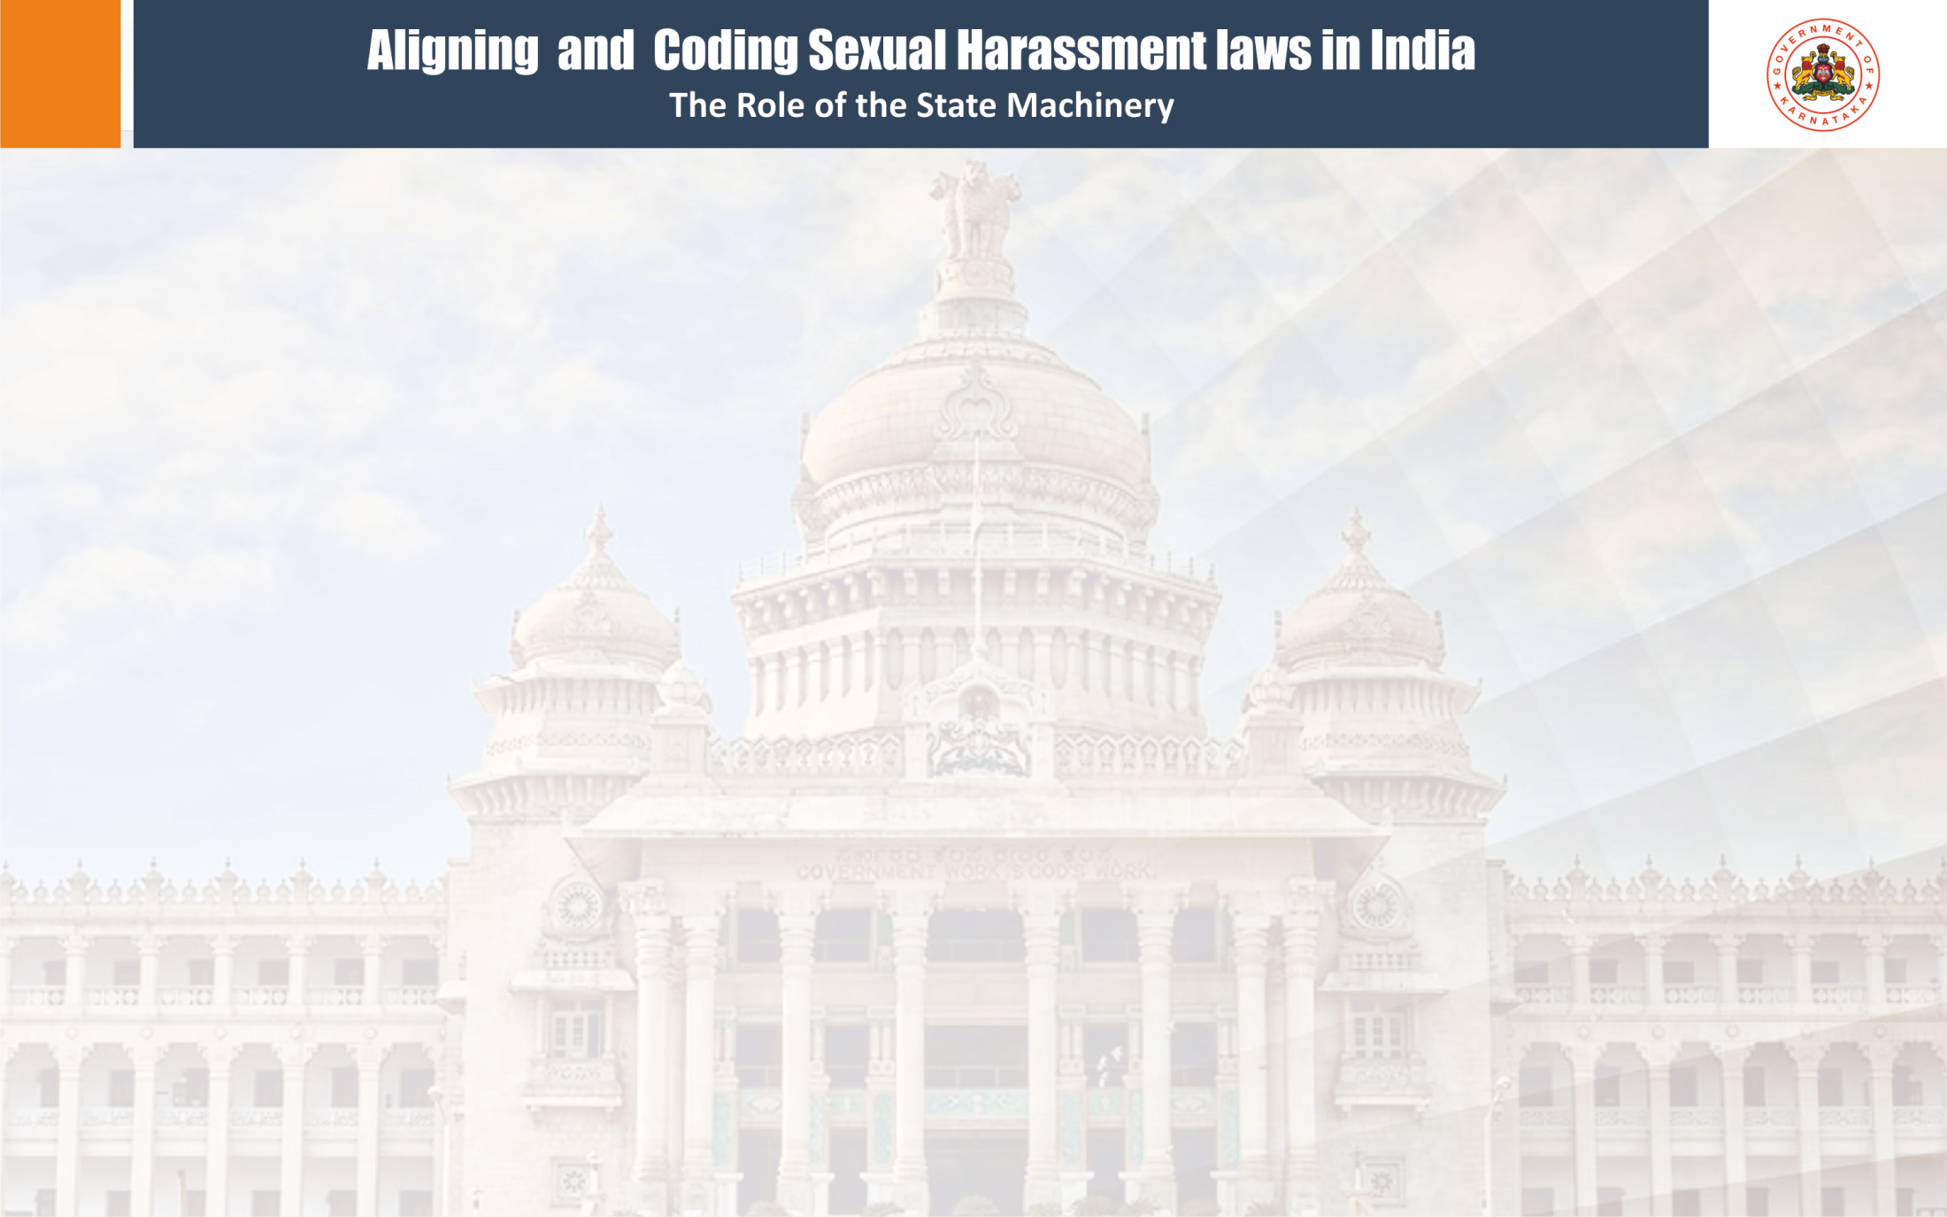
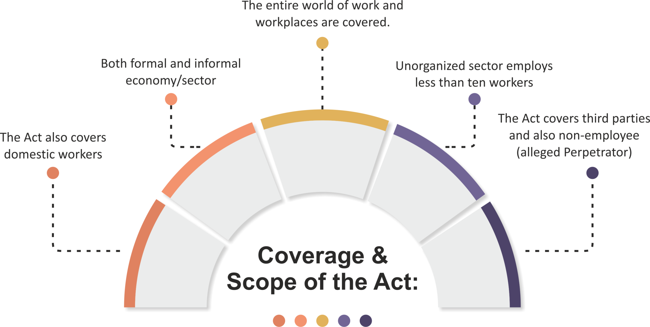

Slide 4

Local Complaints Committee:
Duty of the District officer to exercise powers or discharge functions under this Act.
She/he has to be notified by the appropriate Government.
Statutory duty of such District Officer to constitute a committee called “Local Complaints Committee” (LC for short)
LC is authorized to receive complaints of sexual harassment from establishments where ICC has not been constituted due to having less than ten workers and if the complaint is against the employer himself.

Slide 5
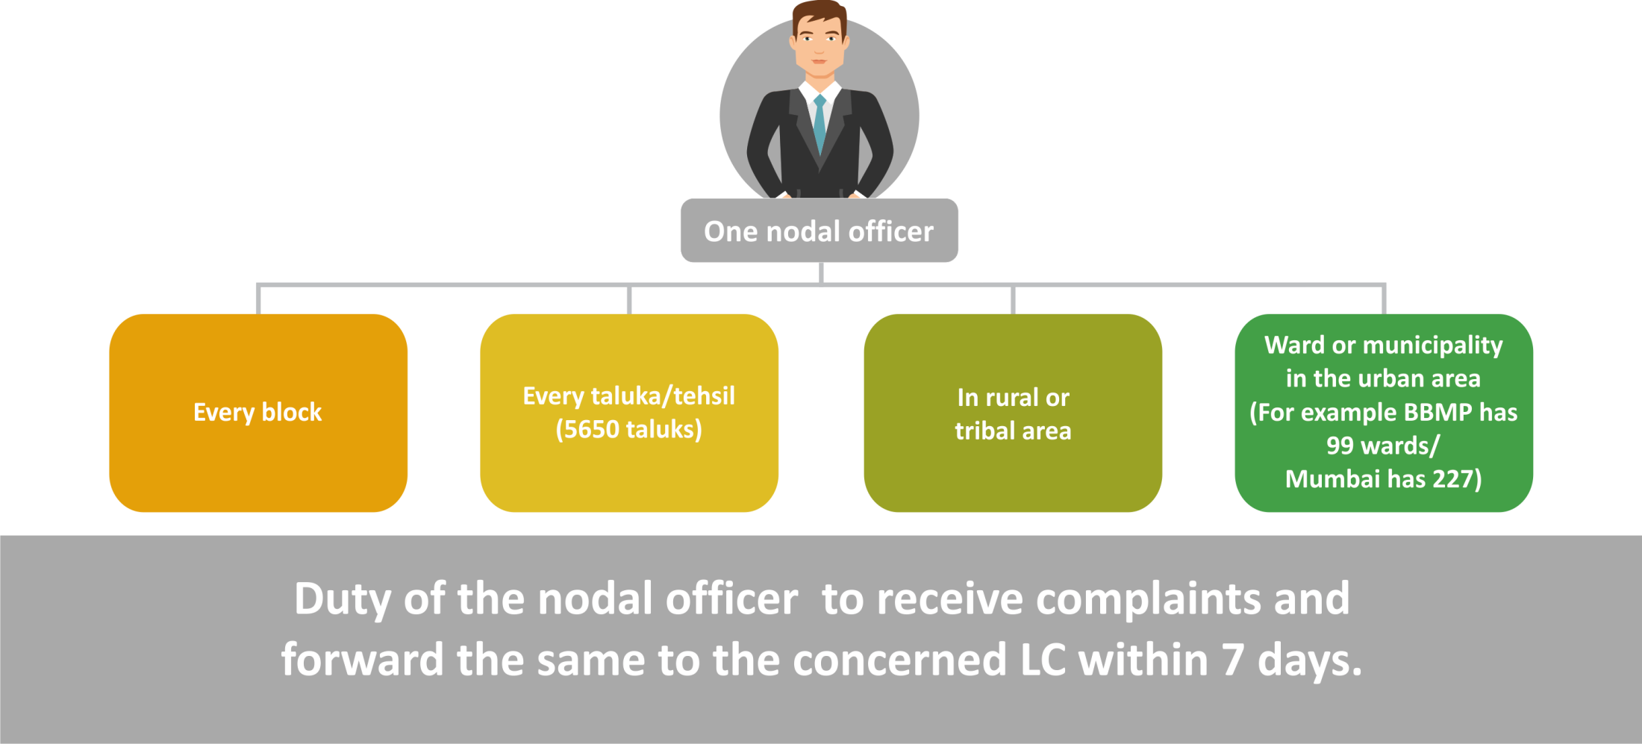
The District Officer shall designate

Slide 6


District Officer shall nominate
The following members to the LC
One member amongst women working in block, taluka or ward (official)
Two members, one shall be a woman amongst NGOs or CSOs
(non-officials)
An officer from SWD or W&CD in the district -ex-officio.
Chairperson
an eminent women
(non-official)
Total members 5, three shall be women.
Nominees to have legal background and one of them shall be
woman belonging to SC/ST/OBC/MC.

Slide 7


Financial support to enforce the Act:
Central Government to provide grants to State Government.
(Annual budgetary allocation)
The State Government to set up an agency and transfer
the grants to that agency.
The agency shall pay to the District Officer
towards conducting the meetings and
expenditure of LC

Slide 8
Sample Survey of the Districts in India
Regarding Constituting LC’s

Slide 10
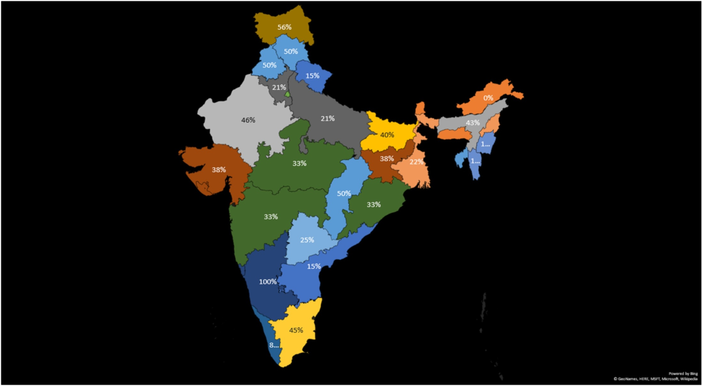
Percentage of LC’s Constituted
State Wise in India

Slide 11
GRAPH DEPICTING VARIOUS CRIMES AGAINST WOMEN IN INDIA FROM 2015 –2018

Slide 12
GRAPH DEPICTING VARIOUS CRIMES AGAINST WOMEN IN KARNATAKA FROM 2015 –2018

Slide 13
Functions of LC
Complaints received through nodal officers
Complaint from a woman, if IC is not constituted.
Initiate conciliation procedure on the request of the aggrieved women and settle the matter.
No monetary consideration can be considered in the settlement.
Investigate the sexual harassment case if the perpetrator is an employee under the service rules, otherwise, Rules prescribes certain punishments like warning, reprimand and also termination from services.
If the complainant is a domestic worker, examine the prima facie of the case and forward the complaint to the Police for registering the case under section 509 of the IPC and any other relevant provisions.

Slide 14

If the complainant is a domestic worker, examine the prima facie of the case and forward the complaint to the Police for registering the case under section 509 of the IPC and any other relevant provisions.
Local committees vested with powers of a civil court under the Code of Civil Procedure, when trying a suit in respect of the following matters:
Summoning, and enforcing the attendance of any person and examining him on oath
Requiring the discovery and production of documents

Slide 15


Duties and Powers of District Officer
The District Officer shall:
Monitor the timely submission of reports furnished by the LC
Take such measures as may be necessary for engaging NGOs for creation of awareness on sexual harassment and the rights of the women.
LC to prepare an annual report and submit it to the District Officer.

Slide 16
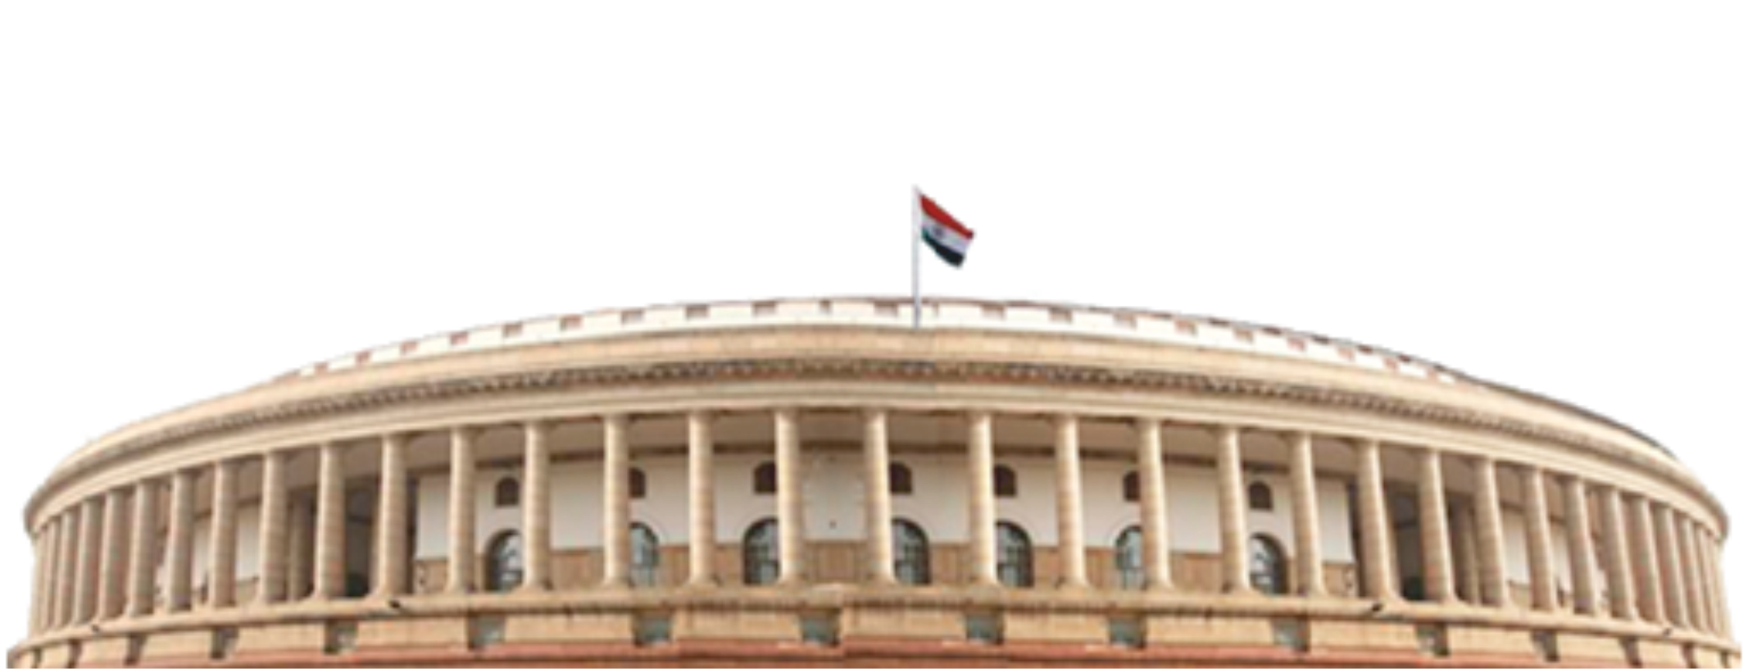
Role of the Appropriate Government:
Shall monitor the implementation of this Act and maintain data on the number of cases filed and disposed off.
To develop relevant IEC and training materials, & organize awareness programmes,
To advance the understanding of the public of the provisions of this Act providing for protection against sexual harassment of woman at workplace.
To formulate orientation & training programmes for the members of LC.

Slide 17
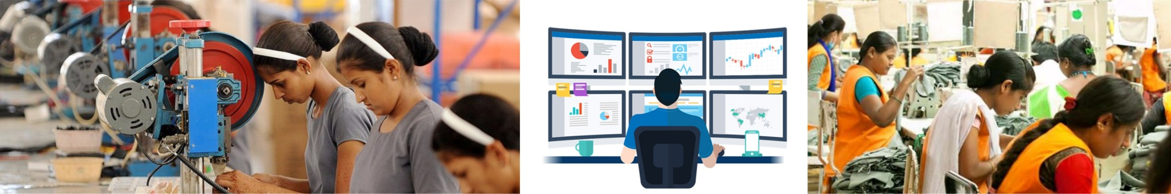
The Government on been satisfied that it is necessary in the public interest or in the interest of women employees at a workplace by order in writing
Call upon any employer or District Officer to furnish in writing such information relating to sexual harassment as it may require
Authorize any officer to make inspection of the records and workplace in relation to sexual harassment, who shall submit a report to government.
Penalty for not constituting the LC is not provided under the Act.
Also for contravening any provisions under the Act and Rules the LC/District officer is exempted.

Slide 18




SHRI BINOY VISWAM:
RAJYA SABHA
UN-STARRED QUESTION NO.2875
TO BE ANSWERED ON 12.12.2019
Will the Minister of WOMEN AND CHILD DEVELOPMENT be pleased to state:
whether Government has set up an Internal Complaints Committee (ICC) in each of its Ministries and other workspaces that fall under the requirement for having an ICC;
what is the total number of complaints filed with ICCs across Government, Ministries and other workspaces;
in how many of the complaints has the allegation been found to be correct;
what action has been taken against those found guilty by the ICC in Government, Ministries and workspaces; and
the data thereof, Ministry-wise?

Slide 19

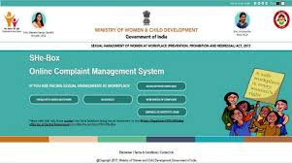
There is no centralized mechanism to collect information about complaints filed with Internal Committees.
However, Ministry of Women and Child Development, Government of India has developed an online complaint management system titled Sexual Harassment electronic–Box (SHe-Box) to facilitate women in registering complaints related to sexual harassment of women at workplace.
As of now, the SHe-Box has 750 complaints, out of which 227 complaints are from various Central Ministries. The Ministry-wise complaints registered through SHe-Box are at Annexure-I.

Slide 20

Aligning with C190
‘violence and harassment’ definition as in Art. 1 of the C.190.
Establishing or strengthening enforcement and monitoring mechanisms-Article 4(2)(d)
Developing tools, guidance, education and training, and raising awareness, in accessible formats –Art.4(2)(g)
Ensuring effective means of inspection and investigation of cases of violence and harassment, including through labour inspectorates or other competent bodies-Art. (4)(2)(h)
Recognizing the important role of public authorities in the case of informal economy worker-Art. 8(a)
Identifying in consultation with the employers’ and workers’ organizations concerned and through other means the sectors or occupations and work arrangements in which workers are more exposed to violence and harassment-Art.8(b)
Integrate violence and harassment risks in the management of OSH-Art.9(b)

Slide 21
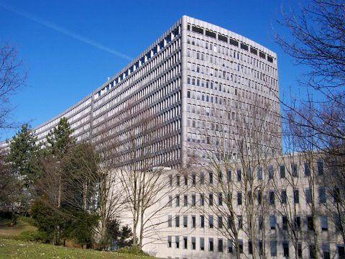
Monitor and enforce national laws and regulations regarding violence and harassment in the world of work-Art.10(a)
Protection against victimization of or retaliation against complainants, victims, witnesses-Art.10(b)(iv)
Legal, social, medical and administrative support measures for complainants and victims-Art. 10(b)(v)
Recognize the effects of domestic violence and, so far as is reasonably practicable, mitigate its impact in the world of work-Art. 10(f)

Slide 22

Aligning with National Laws
Sec. 509 of the IPC – Word, gesture or act intended to insult the modesty of a woman (3.2.13)
Sec. 354 of the Indian Penal Code, 1860-Assault or criminal force to woman with intent to outrage her modesty.(Recent amendment 3.2.2013)
Sec. 354-A. Sexual harassment and punishment for sexual harassment.
Sec. 354-B. Assault or use of criminal force to woman with intent to disrobe.
Sec. 354-C. Voyeurism
Sec. 354-D. Stalking

Slide 23

Aligning with National Laws
Limitations of Service Rules
Limitations of applicability of Industrial Employment (Standing Orders) Act
Amendments to Sec. 134 of the Companies Act 2013, by inserting clause X as follows:
“A statement that the company has complied with provisions relating to the constitution of Internal Complaints Committee under the POSH Act, 2013”
The Indecent Representation of Women (Prohibition) Act, 1986, also covers offences by companies, which are cognizable and bailable.

Slide 24
Summary of the online survey conducted with women and men professionals (100/52) 35w/16m/1o
ONLY 40% of women replied that they agree that POSH Act 2013 is effectively implemented in their organisations, however more men strongly agreed about its effective implementation.
70% of women and 80% of men think that women get justice for the complaints raised at workplace.
60% of women had faith on the capability of LC to conduct a fair enquiry, more men strongly reposed faith in the IC
Women didn’t repose much faith on criminal justice system, that is filing a case with police for SH, men differed a bit on this
Almost 80% of women and 90% of men believed that social norms shape their awareness and understanding about SH
More women believed that government should intervene in handling SH and lesser men believed so.

Slide 25
7. Almost 80% of both women and men believed that there are certain gaps in the POSH Act for its effective implementation
8. Almost 80% of women believed that they face more problems after raising a compliant and men slightly differed on this issue they disagreed on this.
9. 50% of women believed that employers consider the Act as an hindrance to employ them and men slightly differed on this issue they disagreed on this
10. More women didn’t believe that their company considered SH training seriously and men differed on this issue slightly believing that their company has taken training seriously
11. Only 31% of women said that the training on SH brought in change in behaviour of men and women at workplace and again men differed believing that it was largely successful.
12. 60% of both women and men believed that Metoo movement created awareness among them to some extent.

Slide 26
13. 80% of women and men agreed that SH laws should be codified and made simple, yet effective.
14. 60% of women believed that laws relating to women adversely affects their participation in labour markets and 50% of men believed so.
15. 90% of both women and men believed that a long term global perspectives is essential to seek solutions to combat GBV at workplace.

Slide 27

Dr. MANJUNATH G
WELFARE COMMISSIONER, DEPARTMENT OF LABOUR &
DIRECTOR, KARNATAKA STATE LABOUR INSTITUTE ,
GOVERNMENT OF KARNATAKA
www.drmanjunathg.in

