Slide 1
Prevention of Violence and Sexual Harassment at Workplaces and Colleges 20th September 2019 Basaveshwara Degree College, Bengaluru
Dr. G. MANJUNATH, KLS, Phd
WELFARE COMMISSIONER
GOVERNMENT OF KARNATAKA

Slide 2
Contents
Supreme Court of India (DOJ:13-8-1997)
Vishaka vs. State of Rajasthan “Vishaka case”
Supreme Court of India (DOJ: 5-5-2017)
Mukesh vs. State of NCT of Delhi “Nirbhaya case”
The Sexual Harassment at Workplace (Prevention, Prohibition & Redressal) Act, 2013 (Dec 9) POSH
The Criminal Law (Amendment)Act, 2013 (Feb 3)
SAKSHAM –Measures for Ensuring the Safety of women and Programmes for Gender Sensitization on Campuses- UGC (Dec 2013)

Slide 3
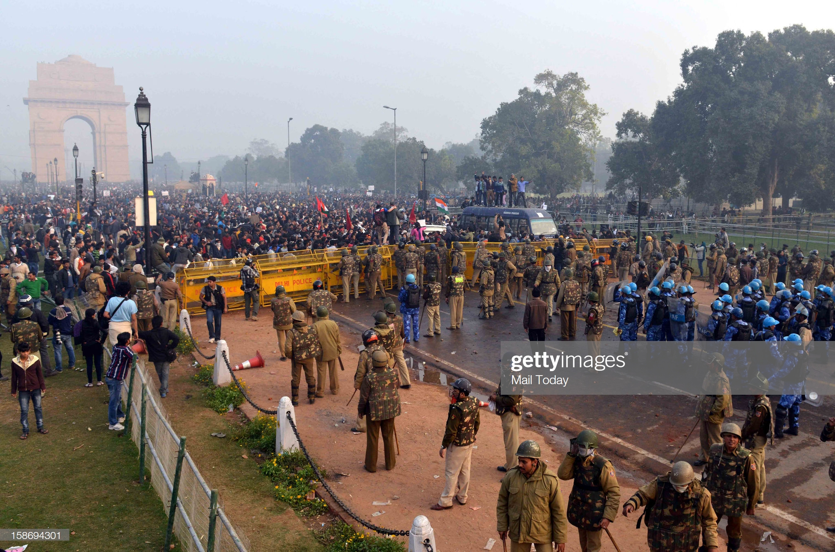

Slide 4
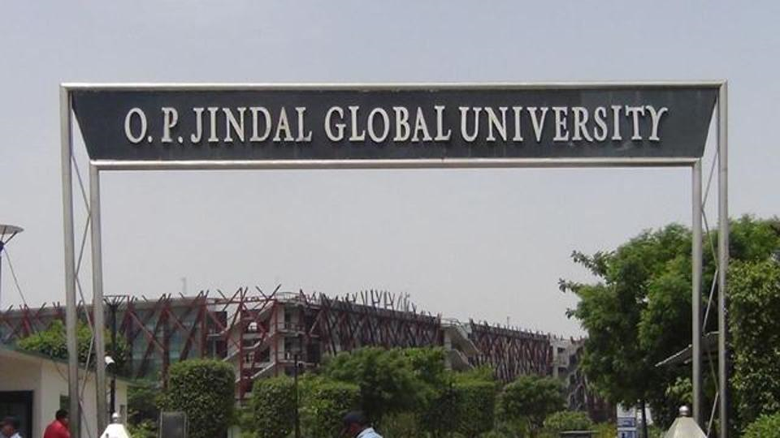

Slide 5
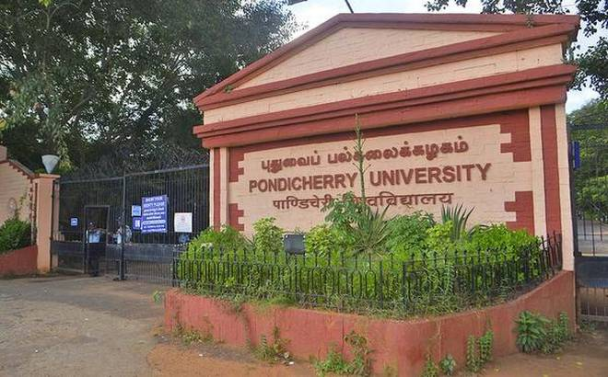

Slide 6
M Kavya vs. The Chairman, UGC. High Court of Madras (DOJ:4/12/2014)
(Anti-ragging and SH case)
Global Jindal University Rape case (Trail court to Supreme Court)

Slide 7


Slide 8


Slide 9


Slide 10
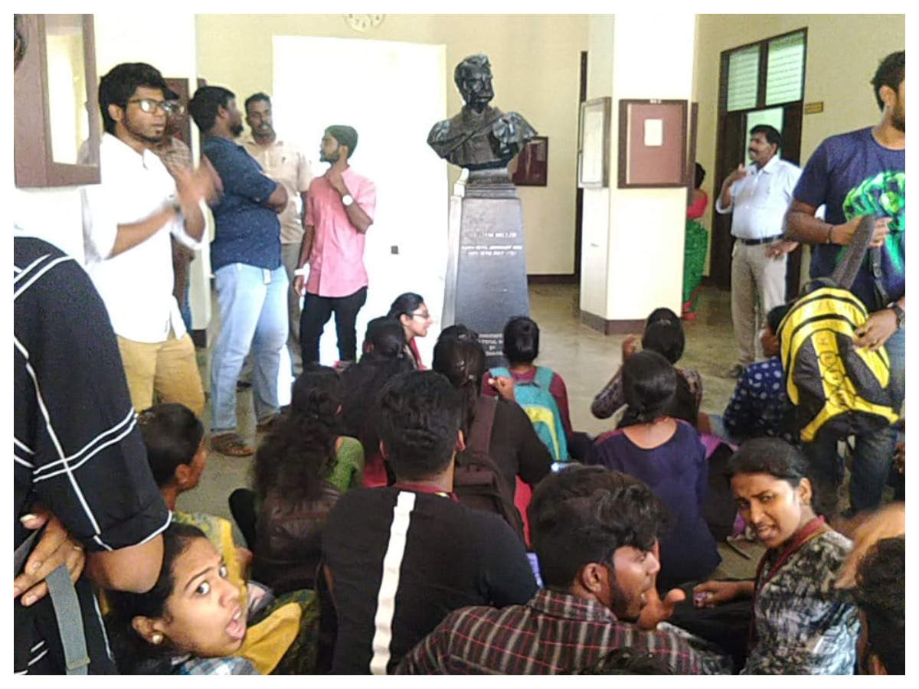

Slide 11


Slide 12
Sec. 2(n) “sexual harassment”
Includes any one or more of the following unwelcome acts or behaviour(whether directly or by implication) namely:-
(i) | Physical contact and advances; or
(ii) | A demand or request for sexual favours; or
(iii) | Making sexually coloured remarks; or
(iv) | Showing pornography; or
(v) | Any other unwelcome physical, verbal or non-verbal conduct of sexual nature

Slide 13

Sec. 2(o) Workplace
It provides six different types of workplaces with elaborate coverage and scope
Sec. 2(o) Workplace includes any department, organization, undertaking, establishment, enterprise, institution, office, branch or unit which is established, owned, controlled or wholly or substantially financed by funds provided directly or indirectly by the appropriate government or the local authority.
Government company
A corporation
A co-operative society
Any private sector organization
A private venture, undertaking, enterprise, institution, establishment, society, trust, non-governmental organization,
Unit or service provider carrying on commercial, professional, vocational, educational, entertainmental, industrial, health services

Slide 14

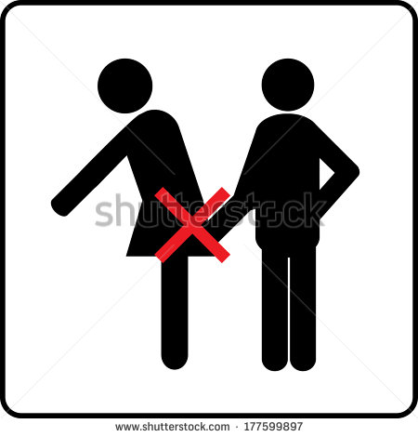
Operative portion of the Act
Sec. 3(1)
Main objective of the Act
Prevention of sexual harassment,- (1) No woman shall be subjected to sexual harassment at any workplace.

Slide 15

Criminal Act Amendments 2013 & its implication in sexual harassment cases
Came into force on 3rd Feb 2013 Insertion of new sections 354A, 354B, 354C & 354D after Sec 354
S. 354-A | Sexual harassment and punishment for sexual harassment.-
S. 354-B | Sec. 354B. Assault or use of criminal force to woman with intent to disrobe.-
S. 354-C | Sec. 354C. Voyeurism.-
S. 354-5 | 354D. Stalking.-
S. 375 & 509 | Rape & Word, gesture or act intended to insult the modesty of a woman.-

Slide 16
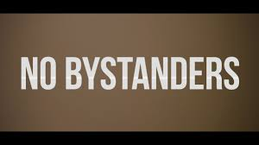

Slide 17
