Slide 1
Fostering Industrial Harmony & Strengthening Business: Practical Insights for Healthy Industrial Relations & Effective Negotiations Industrial Relations & Labour Laws- MDP Christ (Deemed to be University) 06-08-2025
Dr G. MANJUNATH, KLS, Phd
Additional Labour Commissioner (IR)
Government of Karnataka
www.drmanjunathg.in

Slide 2
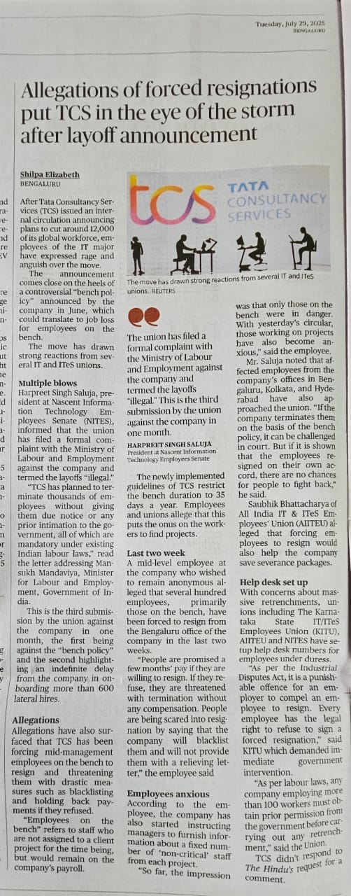
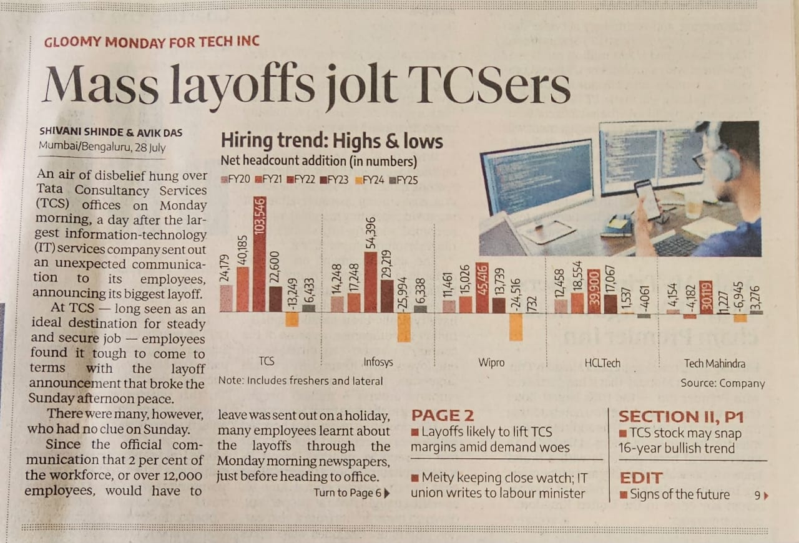

Slide 3
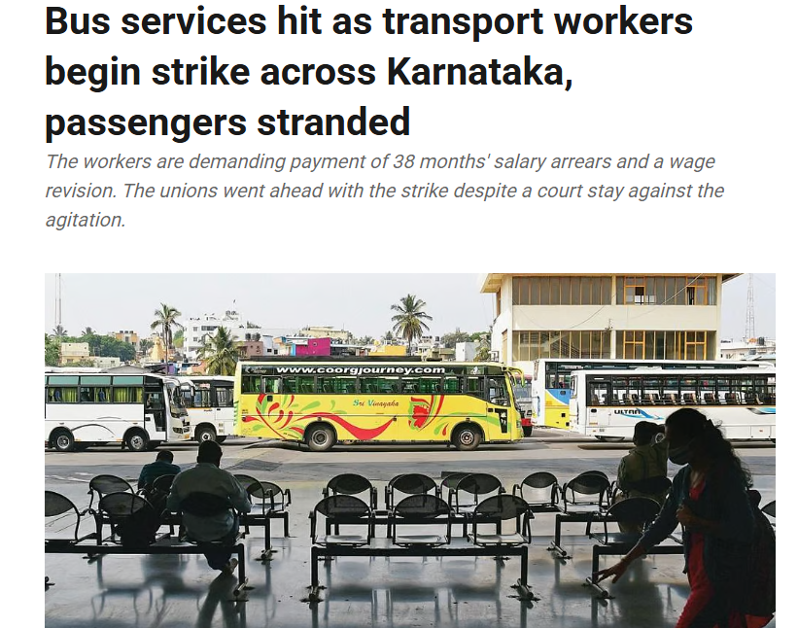
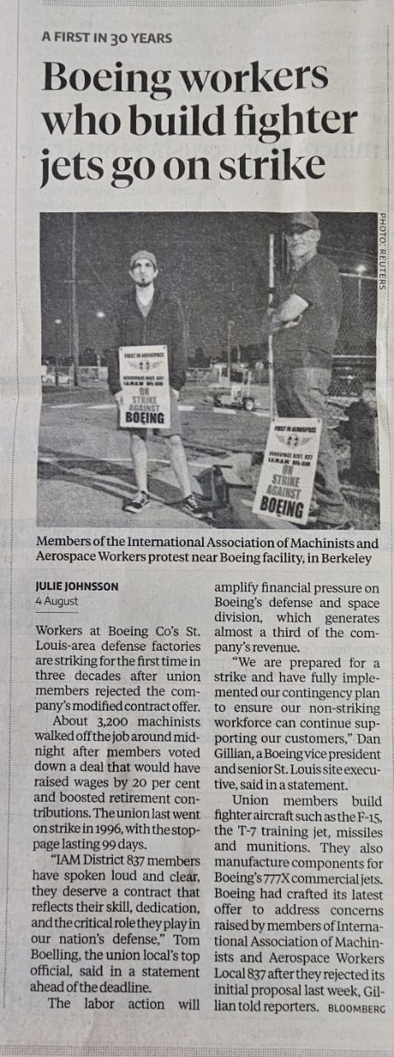

Slide 4
What is settlement under the ID Act?
S 2(p) “Settlement” means a settlement arrived at in the course of conciliation proceeding and includes a written agreement between the employer and workmen arrived at otherwise than in the course of conciliation proceeding where such agreement has been signed by the parties thereto in such manner as may be prescribed and a copy thereof has been sent to an officer authorised in this behalf by the appropriate Government and the conciliation officer;

Slide 5
Role & Duties of the Conciliation officers
S 12(1) Where any industrial dispute exists or is apprehended, the conciliation officer may, or where the dispute relates to a pubic utility service and a notice under section 22 has been given, shall, hold conciliation proceedings in the prescribed manner.
S 12(2) The conciliation officer shall, for the purposes of bringing about a settlement of the dispute, without delay, investigate the dispute and all matters affecting the merits and the right settlement thereof and may do all such things as he thinks fit for the purpose of inducing the parties to come to fair and amicable settlement of the dispute.
S 12(3) If a settlement of the dispute or of any of the matters in dispute is arrived at in the course of the conciliation proceedings the conciliation officer shall send a report thereof to the appropriate government or an officer authorized in this behalf together with a memorandum of the settlement signed by the parties to the dispute.

Slide 6
S 18 Persons on whom settlements and awards are binding
S 18(1) A settlement arrived at by agreement between the employer and workman otherwise than in the course of conciliation proceeding shall be binding on the parties to the agreement.
S 18(3) A settlement arrived at in the course of conciliation proceedings under this Act or an award of a Labour court, Tribunal or NT, which has become enforceable shall be binding on-
(a) all parties to the industrial dispute;
(b) all other parties summoned to appear in the proceedings as parties to the dispute
(c) employer, his heirs, successors, or assigns
(d) all persons employed in the establishment …and all persons who subsequently become employed

Slide 7
R 59 Memorandum of Settlement
R 59(1) A settlement arrived at in the course of conciliation proceedings or otherwise, shall be in Form ‘H’.
R 59(2) The settlement shall be signed by-
(a) in the case of an employer, by the employer himself, or by his authorised agent…
(b) in the case of workmen, by any officer of a Trade Union of the workmen, or by five representatives of the workmen duly authorised in this behalf…
(c) in the case of the workman in an industrial dispute under section 2-A of the Act, by the workman concerned.

Slide 8
S 29 Penalty for breach of settlement or award
Any person who commits a breach of any term of any settlement or award, which is binding on him under this Act, shall be punishable with imprisonment for a term which may extend to six months, or with fine, or with both, and where the breach is a continuing one with a further fine which may extend to two hundred rupees for every day during which the breach continues after the conviction for the first and the court trying the offence, if it fines the offender, may direct that the whole or any part of the fine realised from him shall be paid, by way of compensation , to any person who, in its opinion, has been injured by such breach.

Slide 9
Progress and Settlement under Industrial Disputes Act, 1947 (From 01.01.2023 - 31.12.2023 & 01.01.2024 - 31.12.2024)
Region | Year | Total disputes | Disposal | Pending | Total Amount in terms of settlement | Number of workers covered under the settlement
ADLC (IR) | 2023 | 65 | 64 | 1 | 56,23,00,000 | 3300
 | 2024 | 62 | 54 | 8 | 185.81 Cr | 4450
DLC-1, Bangalore | 2023 | 543 | 425 | 118 | 1,378,498,374 | 4462
 | 2024 | 413 | 322 | 91 | 1,080,299,348 | 6171
DLC-2, Bangalore | 2023 | 421 | 366 | 55 | 2,776,488,600 | 5564
 | 2024 | 339 | 299 | 40 | 2,793,378,682 | 5121
DLC P&S | 2023 | 110 | 84 | 26 | 1,58,53,781 | 277
 | 2024 | 89 | 74 | 15 | 1,80,27,300 | 193
DLC Hassan | 2023 | 100 | 82 | 18 | 29,92,051 | 31
 | 2024 | 85 | 62 | 26 | 10,29,172 | 2
DLC Belagavi | 2023 | 287 | 212 | 75 | 16.50 Cr | 1612
 | 2024 | 263 | 151 | 120 | 94.31 Cr | 3720
DLC Kalaburgi | 2023 | 409 | 337 | 72 | - | -
 | 2024 | 193 | 129 | 64 | 28,979 | 19
Total |  | 3379 | 2661 | 729 | 1159 cr+ | 34922

Slide 10
Graphical representation of the Progress under the ID Act

Slide 11
Settlements/Agreements under Sec 2(p) of the Industrial Disputes Act, 1947
Year | No. of settlements/agreements | No of workers covered
2023 | 68 | 1093
2024 | 37 | 902
Total | 105 | 1995

Slide 12
Tripartite Settlement under 12 (3) & 18 (3) of Industrial Dispute Act, 1947
Year | Number of Settlements
2023 | 29
2024 | 55

Slide 13
Application under Sec – 29 of the Industrial Disputes Act, 1947 (Non implementation of award & Violation of Settlement. (From 01.01.2023 – 31.12.2023 & 01.01.2024 – 31.12.2024)
 | Year | Opening Balance | Application Received | Total | Disposal |  |  | Pending
 |  |  |  |  | No of prosecution permitted | Other than prosecution | Total
ADLC(IR) | 2023 | 69 | 91 | 160 | 50 | 43 | 93 | 67
ADLC(IR) | 2024 | 67 | 59 | 126 | 30 | 57 | 87 | 39
Total |  | 136 | 150 | 286 | 80 | 100 | 180 | 39

Slide 14
Application under Sec – 29 of the Industrial Disputes Act, 1947 (Non implementation of award & Violation of Settlement. (From 01.01.2023 – 31.12.2023 & 01.01.2024 – 31.12.2024)

Slide 15
O/of the Additional Labour Commissioner (Industrial Relations) Report of petitions received in this office, under the Industrial Disputes Act, 1947 (2021-22, 2022-23, 2023-24, 2024-24)
Period | No. of petitions received | Total | Disposal | Pending | No. of wage settlements | Total amount in terms of settlements | No. of workers covered under the settlement
2021-22 | 44 | 44 | 44 | - | 01 | 1,54,96,250 | 1127
2022-23 | 77 | 77 | 77 | - | 01 | 55,51,838 | 30
2023-24 | 53 | 53 | 45 | 08 | 01 | 56,23,00,000 | 3300
2024-25 | 50 | 58 | 46 | 12 | 03 | 185,81,00,000 | 4450
Total | 224 | 232 | 212 | 12 | 06 | 244,14,48,088 | 8907

Slide 16
Trade Union Registrations (From 01.01.2023 - 31.12.2023 & 01.01.2024 - 31.12.2024)
Region | Year | No of Trade Unions registered | Total Workers | No of Male Workers | No of Female Workers | No of formal workers | No of informal workers
DLC-1, Bangalore | 2023 | 33 | 3560 | 3165 | 395 | 1149 | 2411
 | 2024 | 21 | 1551 | 1379 | 172 | 476 | 1075
DLC-2, Bangalore | 2023 | 32 | 9938 | 8843 | 1095 | 1010 | 8071
 | 2024 | 21 | 2475 | 2128 | 347 | 284 | 2191
DLC P&S | 2023 | 24 | 2677 | 2380 | 297 | 446 | 2231
 | 2024 | 26 | 2378 | 2127 | 251 | 450 | 1928
DLC Hassan | 2023 | 18 | 2545 | 2043 | 502 | 488 | 2057
 | 2024 | 8 | 948 | 714 | 234 | 320 | 628
DLC Belagavi | 2023 | 51 | 6092 | 5233 | 859 | 0 | 6092
 | 2024 | 68 | 7867 | 6838 | 1029 | 0 | 7867
DLC Kalaburgi | 2023 | 27 | 3007 | 1998 | 1009 | 890 | 2117
 | 2024 | 19 | 2222 | 1850 | 372 | 525 | 1697
Total |  | 348 | 45260 | 38698 | 6562 | 6038 | 38365

Slide 17
Graphical representation of Trade Union Registrations

Slide 18
Public Grievances (Petitions) (From 01.01.2023 - 31.12.2023 & 01.01.2024 - 31.12.2024)
Region | Year | Total Petitions | Disposal | Pending Petitions
DLC-1, Bangalore | 2023 | 1176 | 835 | 341
 | 2024 | 1193 | 802 | 391
DLC-2, Bangalore | 2023 | 1390 | 1099 | 291
 | 2024 | 1403 | 1089 | 314
DLC P&S | 2023 | 60 | 60 | 0
 | 2024 | 30 | 30 | 0
DLC Hassan | 2023 | 266 | 226 | 40
 | 2024 | 184 | 135 | 49
DLC Belagavi | 2023 | 405 | 181 | 227
 | 2024 | 420 | 137 | 285
DLC Kalaburgi | 2023 | 339 | 229 | 110
 | 2024 | 199 | 116 | 83
Total |  | 7065 | 4939 | 2131

Slide 19
Public Grievances (Petitions) (From 01.01.2023 - 31.12.2023 & 01.01.2024 - 31.12.2024)
Region | Year | Total Petitions | Disposal | Pending Petitions
DLC-1, Bangalore | 2023 | 1176 | 835 | 341
 | 2024 | 1193 | 802 | 391
DLC-2, Bangalore | 2023 | 1390 | 1099 | 291
 | 2024 | 1403 | 1089 | 314
DLC P&S | 2023 | 60 | 60 | 0
 | 2024 | 30 | 30 | 0
DLC Hassan | 2023 | 266 | 226 | 40
 | 2024 | 184 | 135 | 49
DLC Belagavi | 2023 | 405 | 181 | 227
 | 2024 | 420 | 137 | 285
DLC Kalaburgi | 2023 | 339 | 229 | 110
 | 2024 | 199 | 116 | 83
Total |  | 7065 | 4939 | 2131

Slide 20
Graphical representation of the Public Grievances

Slide 21
Total No of Awards passed by Labour Court/IT/AIT
Year | No of awards passed
2023 | 2015
2024 | 1845
Total | 3860

Slide 22
Non Implementation of Awards/ Settlements (From 01.01.2023 - 31.12.2023 & 01.01.2024 - 31.12.2024)
Year | No of complaints raised | Disposal | Pending | No of Prosecutions permitted | Other than prosecution
2023 | 160 | 93 | 67 | 50 | 43
2024 | 126 | 87 | 39 | 30 | 57
Total | 286 | 180 | 106 | 80 | 100

Slide 23
Graphical representation of Non- Implementation of Awards/Settlements

Slide 24
Industrial Harmony & Legal Framework
What is Industrial harmony? Is it an Utopian concept? Have we achieved social harmony? Are we aiming at achieving justice & equity? | What is the Legal Framework? ID ACT IE(SA) ACT TU ACT…. Constitutional framework Judge made laws
Guiding Principles: Fairness Principles of Natural Justice Equity Gender Justice Equal opportunity Empathy Business ethics & corporate citizenship | Practical Approaches: Engagement Mutual respect Trust building Negotiations Sustainability Legality Leadership

Slide 25
Approaches to IR conflict resolution & settlement of disputes
Top Management involvement – Altruistic approach | Dynamatic Aerospace : DOS – 17.01.2023 Involvement of MD WCPM: DOS: 28.10.2024 Involvement of ED (JNC) Hindalco DOS: 20.10.2024 Active participation to resolve the COD
Mid-Level Management & Effective Trade Unionism – Proactive approach | M/S TKM Ltd : DOS 24.07.2024 M/S Exedy Clutch India Pvt Ltd. DOS: 24.07.2024
Top Management & Trade Unions – Egocentric approach | *** Bengaluru – Failure – plenty of litigation ***Dharwad – Failure – plenty of litigation ***Bengaluru – Failure – plenty of litigation
New Management & New internal Trade Union – Emerging leadership | 1. M/S tata Electronics systems Solutions Pvt Ltd : DOS 08.11.2024

Slide 26
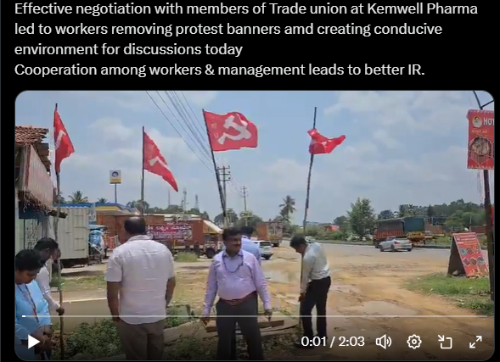

Slide 27
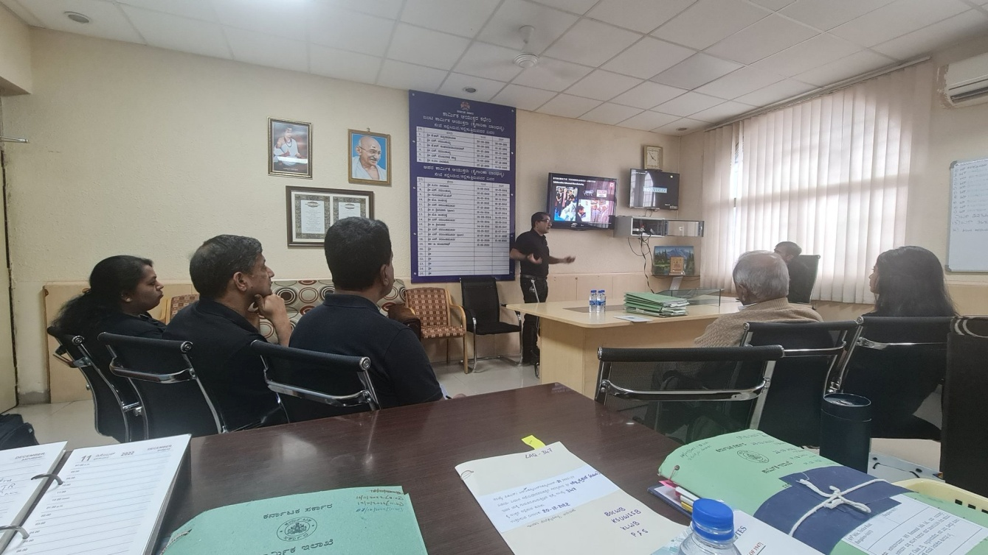
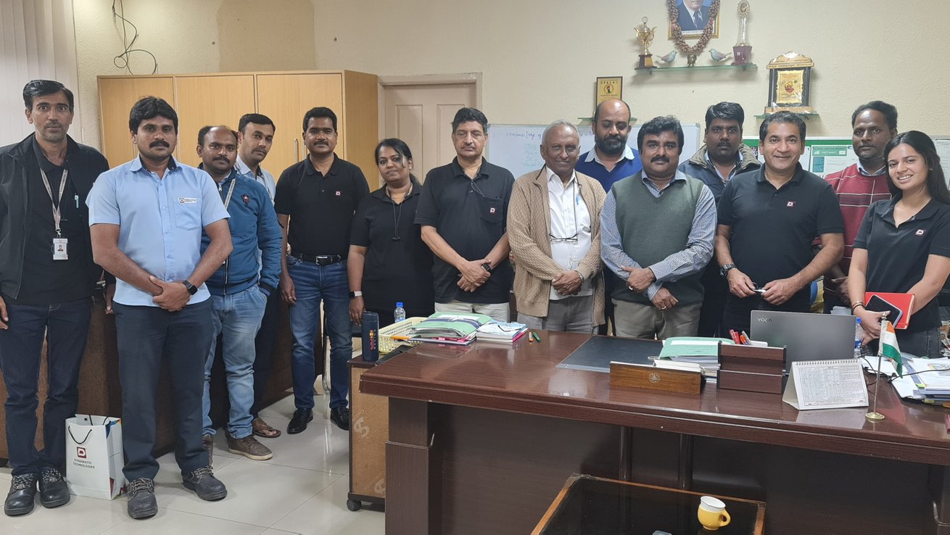
Dynamatic Technologies Ltd, Altruistic approach

Slide 28
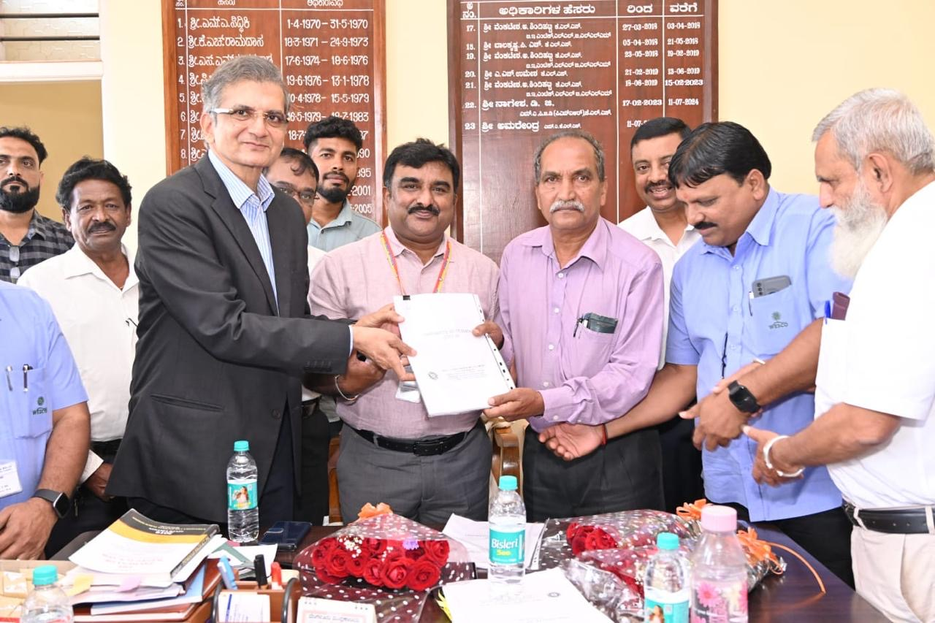
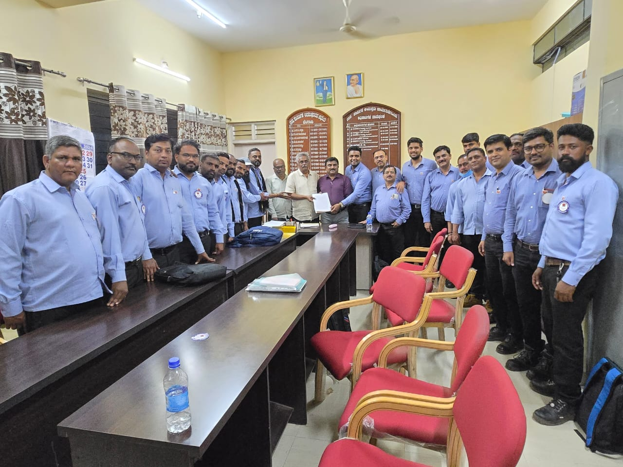
West Coast Paper Mills Ltd, Dandeli, UK
Aditya Birla/ Hindalco Industries, Belgaum

Slide 29
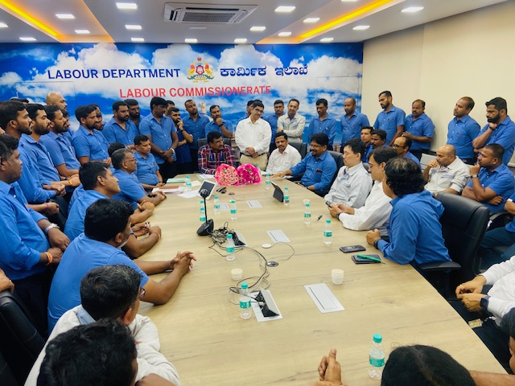
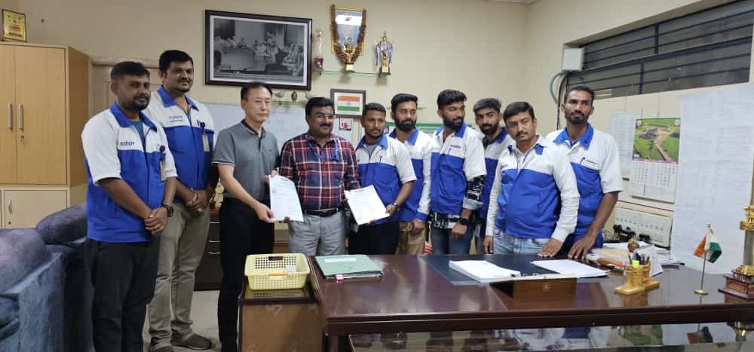
Toyota Kirloskar Motor Pvt Ltd, Bidadi
Exceedy Clutch India Pvt, Ltd, Narasapura

Slide 30
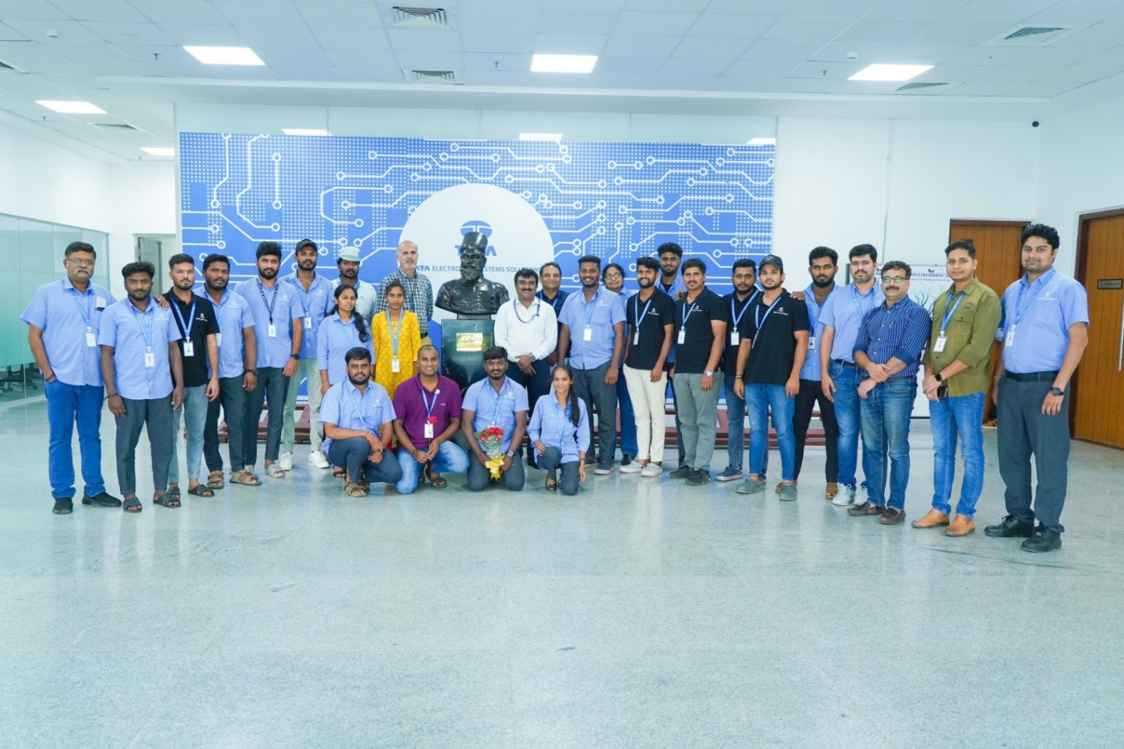
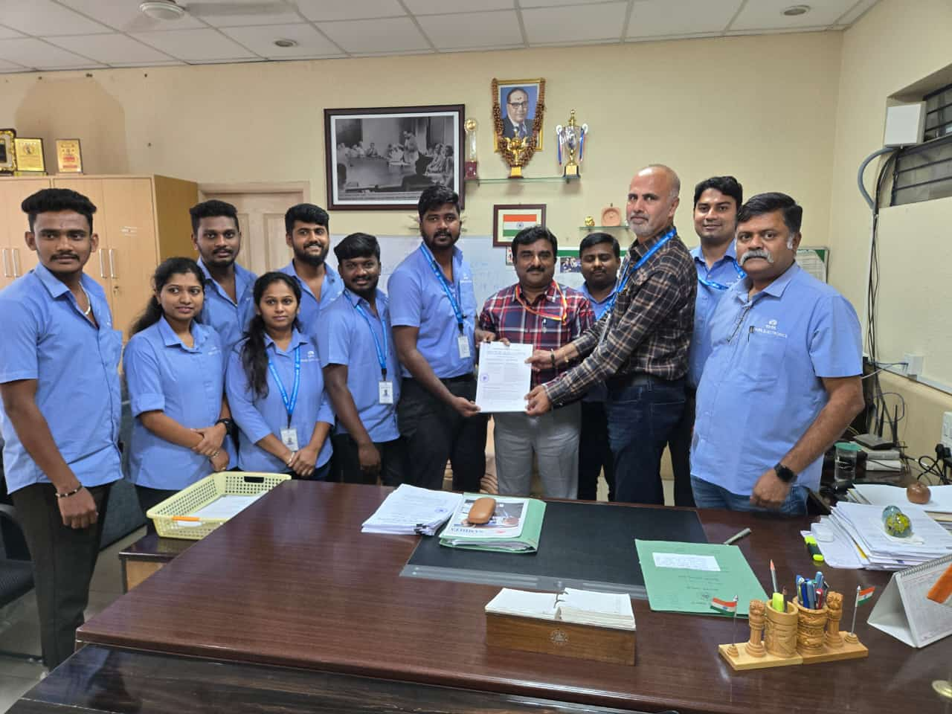
Tata Electronics Systems Solutions, Narasapura

Slide 31
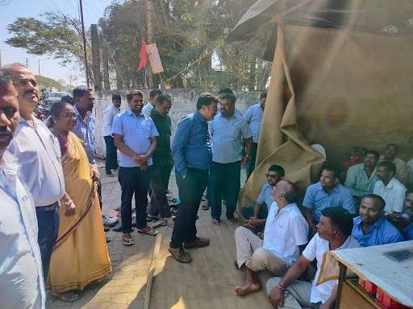
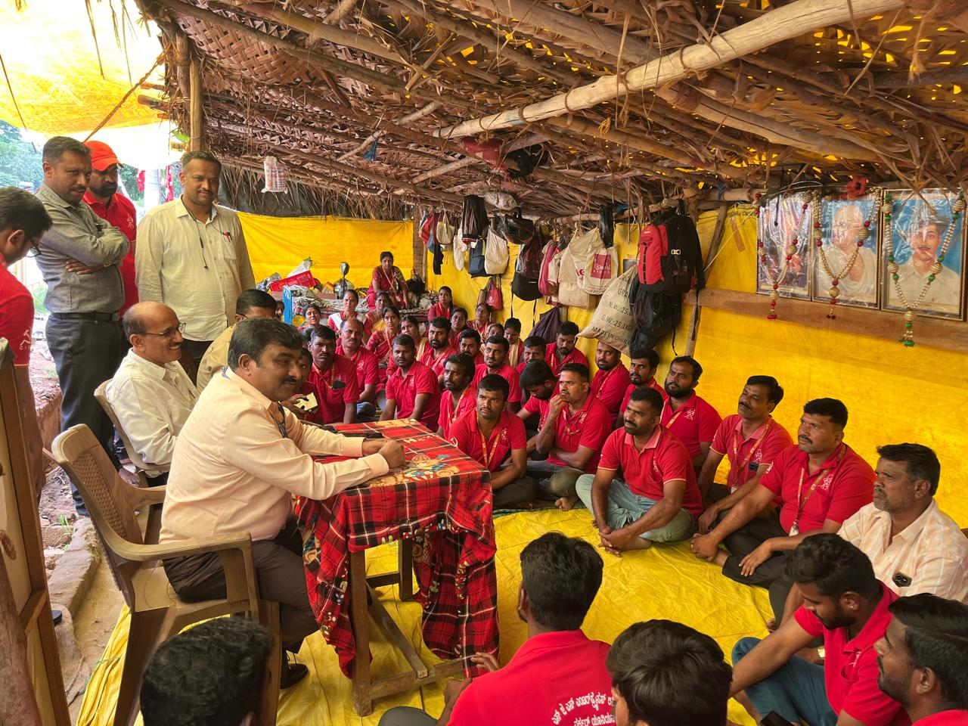
SJS Enterprises, Bengaluru
Gramox Paper & Boards Ltd, Nanjangud, Mysore

Slide 32
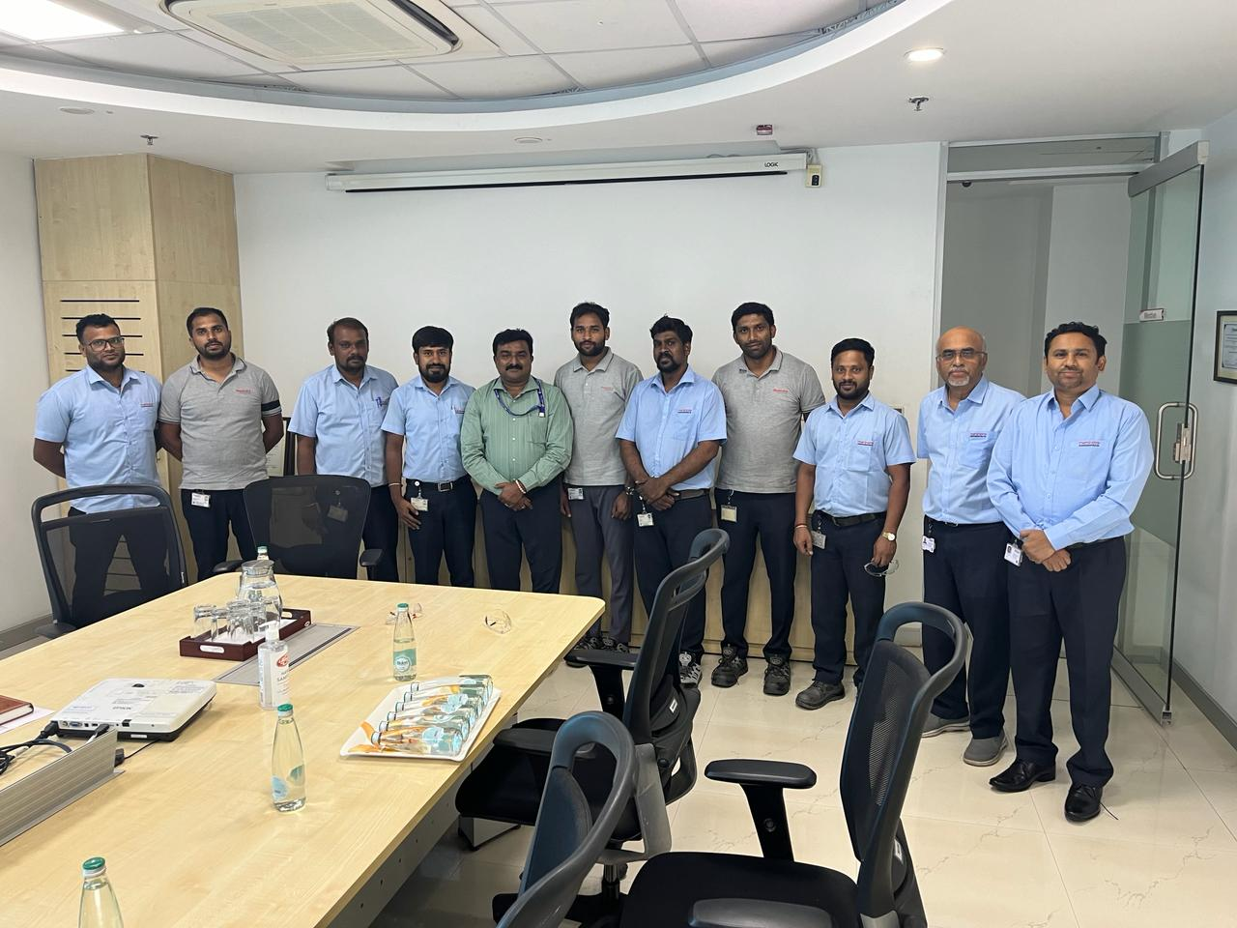
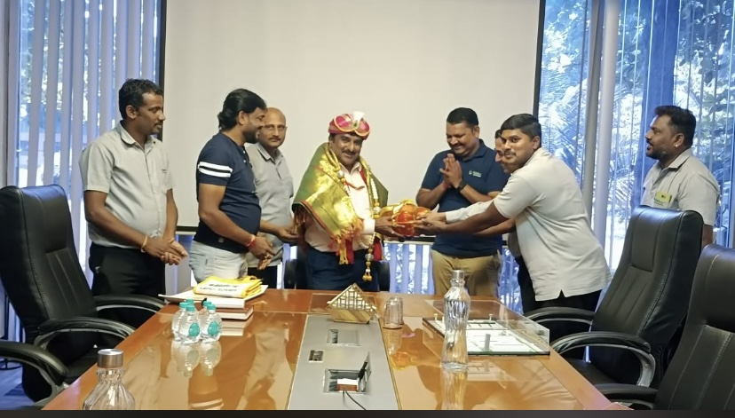
Mahindra Aerostructure Pvt Ltd
Nidec Industrial Automation India Pvt Ltd

Slide 33
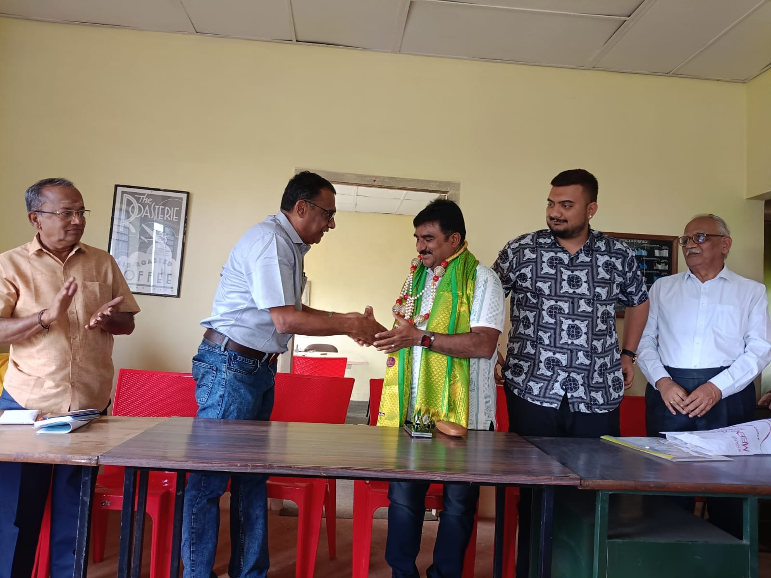
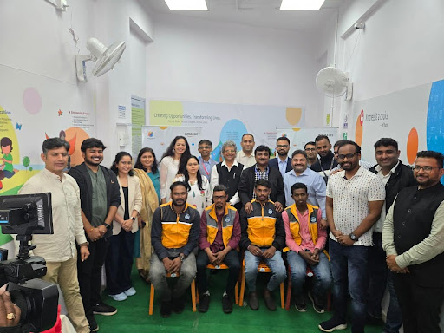
Alageshwara Estate, Chickmagaluru
Amazon India, Bengaluru

Slide 34
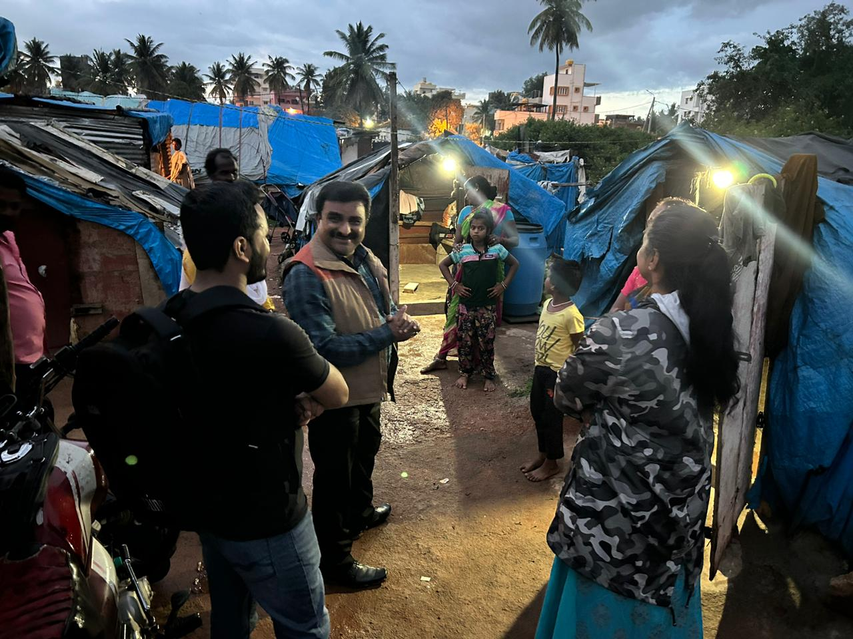
Laggere construction workers colony

Slide 35
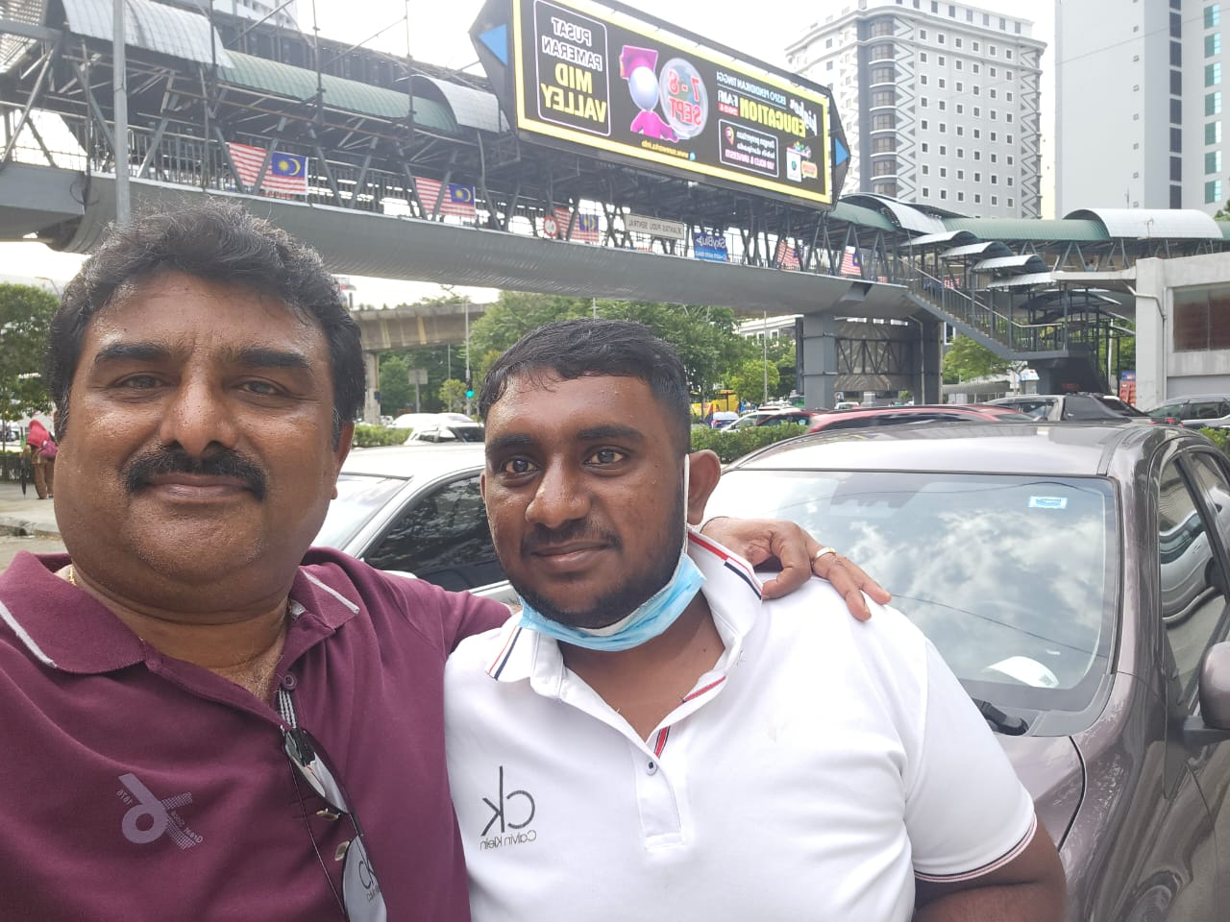
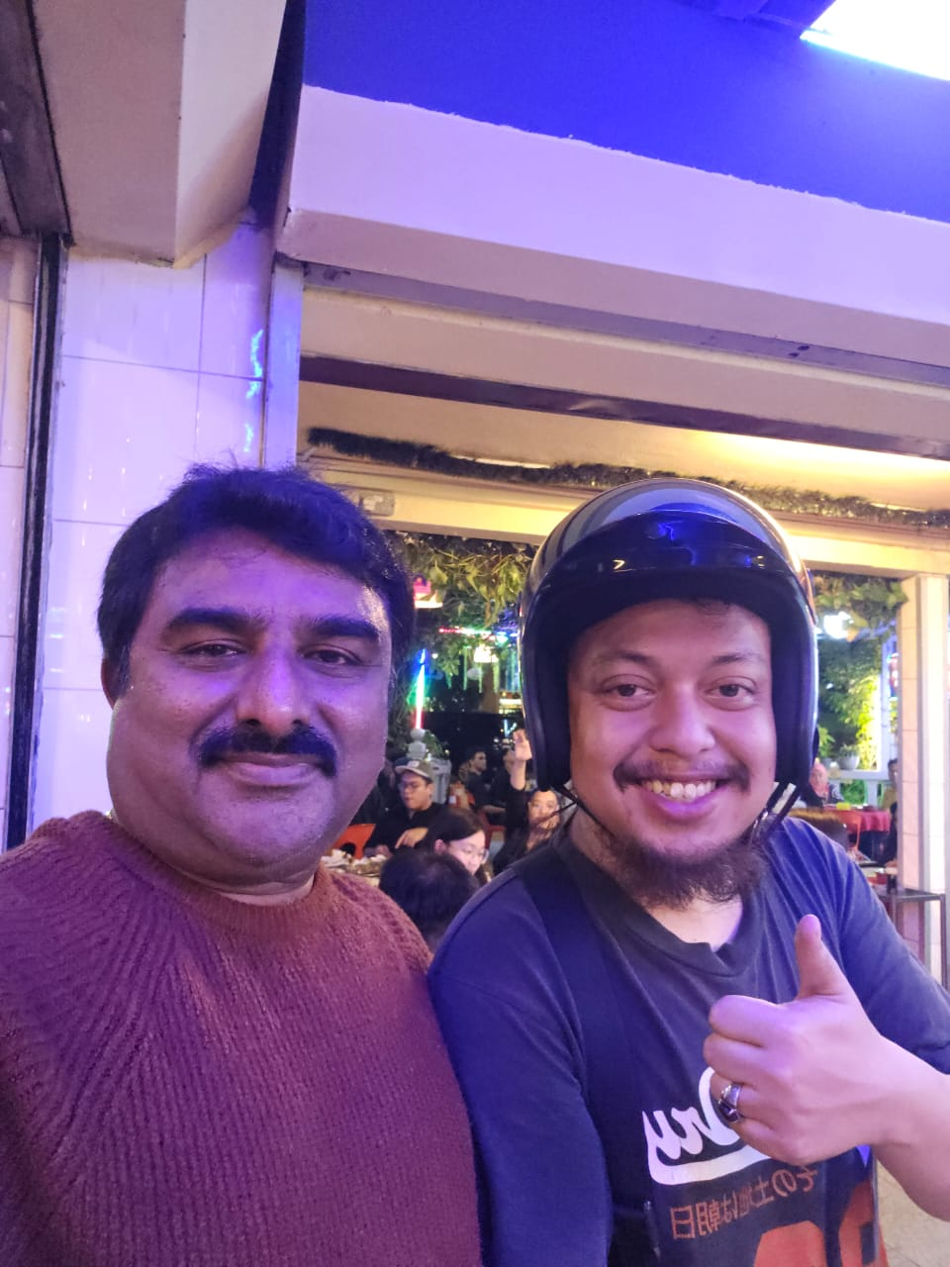

Slide 36
Qualities of an effective Conciliation officer
Patience vs Impatience/ anger Knowledge vs ignorance/lack of understanding Fairness vs Bias Independent vs succumbing to pressure Impact assessment vs cluelessness Business requirements vs business ethics Workers requirements vs sustainability Wider perspective vs narrow perspective Persuasion power vs ineffectiveness Leadership vs powerlessness & in capacity

Slide 37
Emerging IR/Labour market scenarios
Are Business profits increasing? – Economic Survey 2024 Are workers getting their due share? (wages, incentives, bonus, social security benefits etc) How are employers consolidating their positions? Powers? – Capitalist hegemony (Influence of CII, NASCOM etc) Will deregulation & EODB solve the problems of stakeholders? How are workers consolidating their positions? Powers? Are they success in their approach to better the lives of working class? Can workers’ rights be protected under neo-liberal political economy? How is judiciary including quasi-judiciary responding to the present crisis? How are government across various political systems responding to the present crisis? How to regulate the news forms of employment and work arrangements? (Platforms & gig works) What would be the impact of AI and the future of work?

Slide 38
Related matters
Use and abuse of provisions under the Act
Unfair labour practices
Closures, retrenchments under chapter V-A
Notice of change – 9A
Transfers
Trainees and apprentice
Contract labour engagement and discontents
Migrant labour
IT –ITES Sector – issues
Gig economy and platforms
Local candidates sentiments

Slide 39
Related matters
Multiplicity of disputes with various authorities
Non-state actors
sovereign functions
Regulatory machineries and quasi-juducial authorities
Impact of New Labour codes on the IR/HR

Slide 40
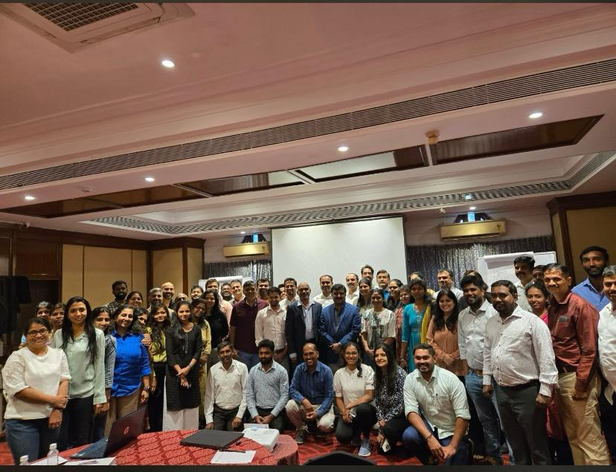
Workshop on Labour codes attended by HR/IR professionals.

Slide 41
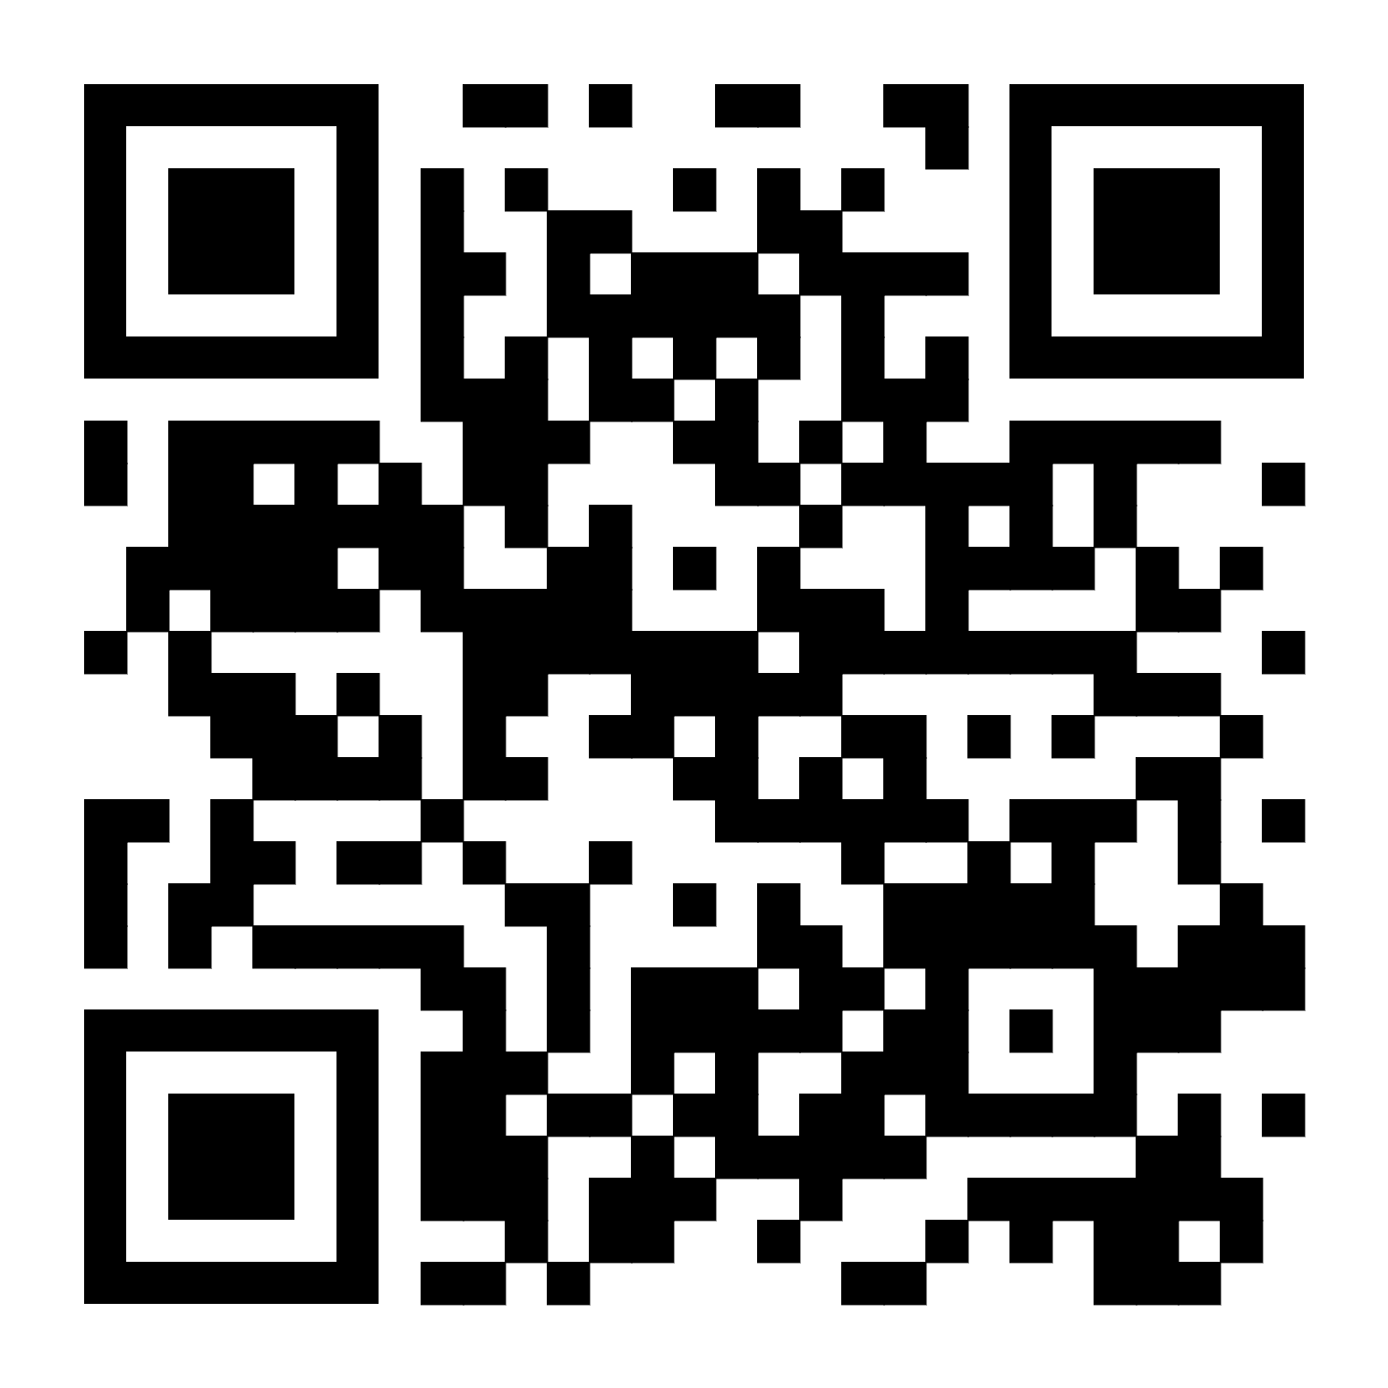
Industrial Relations & Trade Union Perception Survey

Slide 42
Thank you Q&A

